Slide 1
Digital Portfolio
STUDENT NAME: MADHUMITHRA M
REGISTER NO :2428c0483
NMID: 86E0AC0132D6E99910346C09B42405CE
DEPARTMENT: BSc.AIML
COLLEGE: KPR College Of Arts Science and Research

Slide 2
PROJECT TITLE
ja
Lab-Technician Portfolio

Slide 3


AGENDA
Problem Statement
Project Overview
End Users
Tools and Technologies
Portfolio design and Layout
Features and Functionality
Results and Screenshots
Conclusion
Github Link
3/21/2024 Annual Review

Slide 4

PROBLEM STATEMENT
The need to demonstrate technical proficiency, clinic reliability, and accuracy in lab settings.
Scarcity of easily accessible documentation showcasing lab skills and achievements.
A digital portfolio helps in highlighting knowledge, experience, and technical certificates effectively.

Slide 5

PROJECT OVERVIEW
A comprehensive lab technician portfolio—either digital (web-based) or document-based—covering:
Education & Certifications (e.g., pathology, microbiology, safety training)
Laboratory Skills (e.g., sample collection, analysis, equipment sterilization)
Case Studies (e.g., diagnostic accuracy, troubleshooting incidents)
Quality Control Records
Contact Information
Serves as a professional summary for job applications, internships, or academic evaluation.

Slide 6

WHO ARE THE END USERS?
Faculty & Educators – to assess competency and training coverage
Hiring Managers & Clinical Labs – for recruitment and staffing evaluation
Research Supervisors – when engaging in lab-based projects
Peers & Professional Network – to build trust and credibility

Slide 7

TOOLS AND TECHNIQUES
HTML5 – for structuring web pages (About Me, Skills, Contact, etc.)
CSS3 – for styling and responsive layout
JavaScript (ES6) – for interactivity and dynamic features
Git & GitHub – for source code management and portfolio hosting
VS Code – used for development

Slide 8
POTFOLIO DESIGN AND LAYOUT
Home page with introduction
About me (education, certifications)
Skills (lab techniques, tools)
Projects/Case studies
Contact details
Clean, professional, and easy to use
.
8

Slide 9
FEATURES AND FUNCTIONALITY
User-Friendly Navigation – Easy movement between portfolio sections
Interactive Elements – JavaScript-based effects (menus, buttons)
Responsive Design – Optimized for multiple devices
Showcase Section – Highlighting certificates, reports, or projects
Contact Form/Links – Easy communication via email or GitHub

Slide 10
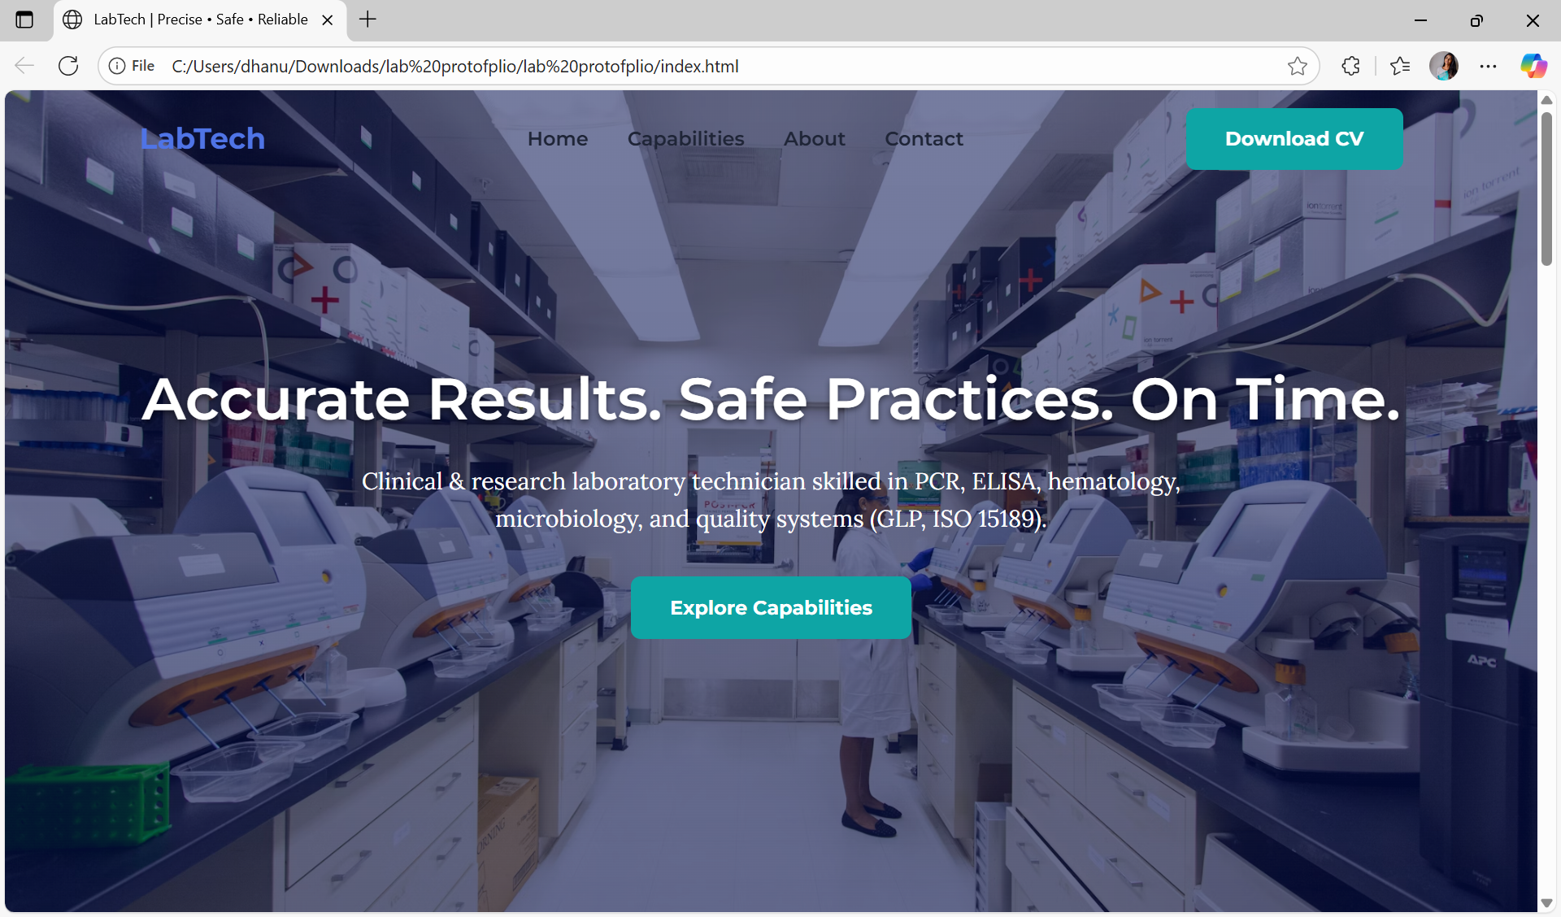
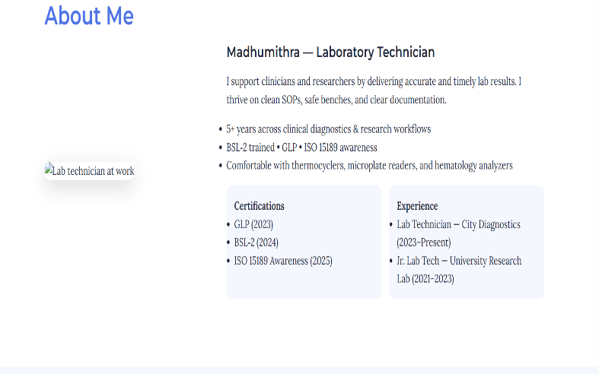

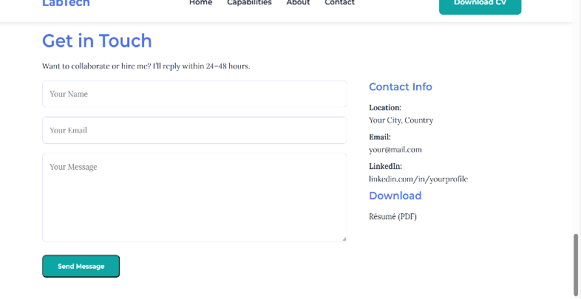
RESULTS AND SCREENSHOTS
Successfully built a digital portfolio showcasing skills and achievements
Improved professional visibility through GitHub-hosted website
Organized and easy-to-access record of technical skills
3/21/2024 Annual Review
10

Slide 11
CONCLUSION
Portfolio demonstrates academic, clinical, and technical skills of a Lab Technician
Combines professional content with digital presentation skills
Serves as a powerful tool for job applications, internships, and academic evaluation
11

Slide 12
GitHub Link
https://github.com/madhumithra09/Lab-Technician-Portfolio

